Slide 1
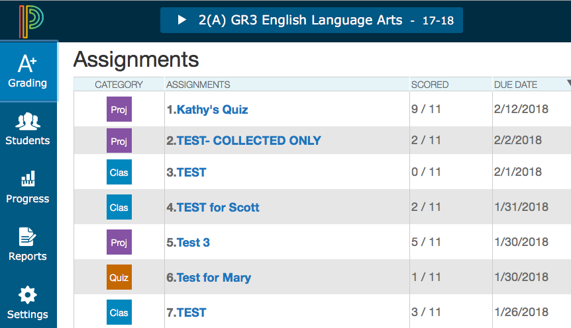


PowerTeacherPro and Standards
Bob Cornacchioli
get2bobc@gmail.com
http://www.derotechnical.com

Slide 2

Agenda/Participants will be engaged in:
Standard grading in PTP
What’s new in PTP
Standards, Assignments, Comments, Conversions
Professional Judgements
Overwrite vs Changing Which Three
I also have a PDF – Navigational Differences between
PTG and Unified Classroom/PTG 2.0
JUST ASK
www.derotechnical.com
get2bobc@gmail.com
for more resources

Slide 3




CEO - DERO Technical Services (2007)
Marketing/- ParkBench Software Trainer (2007)
Evangelist/Process Lead- Level Data (2010)
PSISJS Partner – Standards/Trainer (2013)
Alpha/Beta Team for PS and PTP
Bob Cornacchioli
Director of Technology and Media Services
Shrewsbury Public Schools (16 yrs.)
PowerSchool Administrator (6 yrs.)

Slide 4



What’s your role in the district?
How long have you grading standards?
Do you recall the transition process from traditional to standards grades?

Slide 5

How long did it take?
ABCDEF to 4/3/2/1 or OSUN
Designing
Report Card
Curriculum Review
NEW Assessments
SPECIAL NEEDS
GIFTED
Grading Best
Practices
Comment
Narrative/Bank
Gradebook
Training
DATA ANALYSIS
Evaluation Student
Work Samples
TRANSITION TIME
12-24 months
Assignments/
Final Entry
ON-GOING PD
Communication
Plan
Professional
Judgement
Performance
Indicators
Standards
Selection
Paradigm
Shift PD
Why
Standards

Slide 6
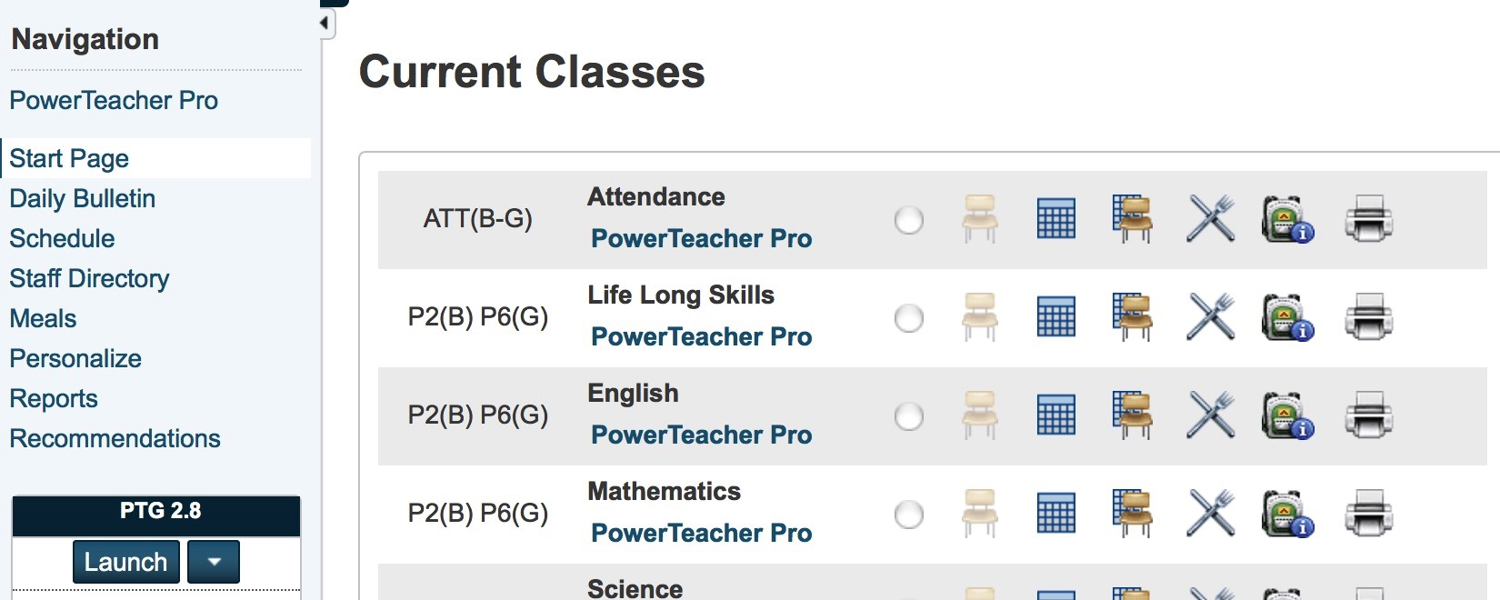
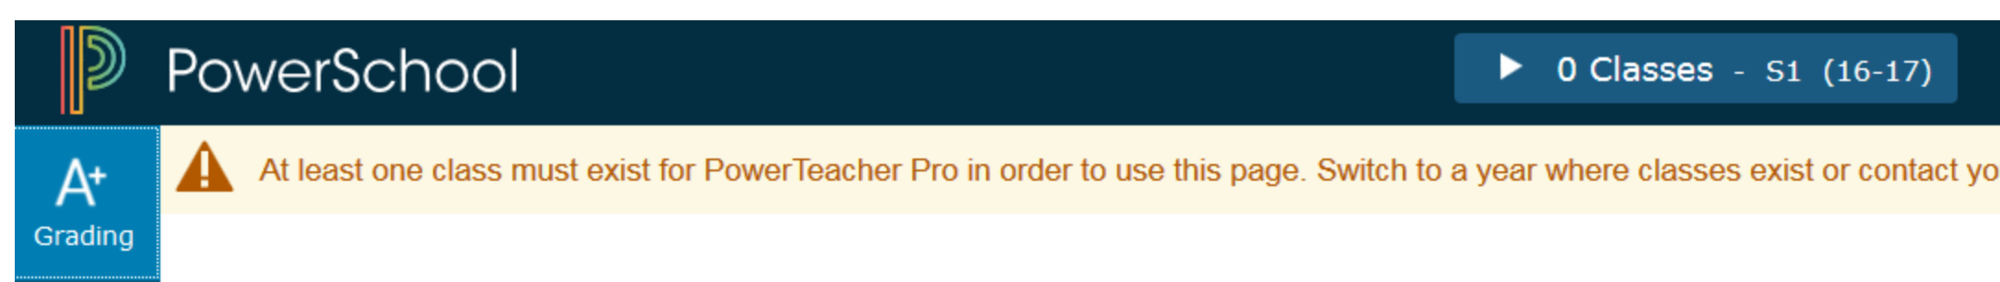
Launching PTP Gradebook
PTP – is built into PowerSchool, once you log in and your sections have been designated as PTP Gradebook – you will see a PowerTeacherPro link in blue at the top of the Navigational bar on the left OR beneath each of your Current Classes.
X

Slide 7
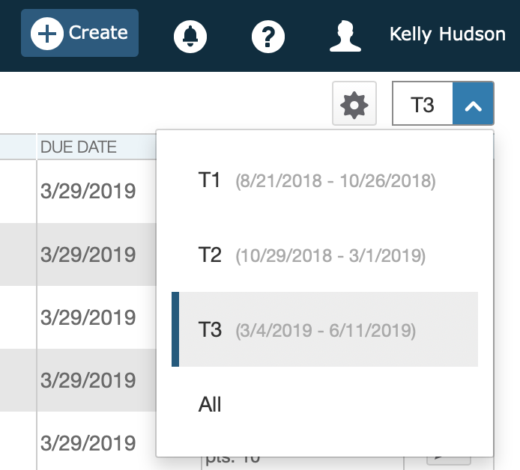
SELECTING the CORRECT TERM STILL
REMAINS VERY IMPORTANT
Especially at the end of term,
When the server automatically switches to the next term!

Slide 8
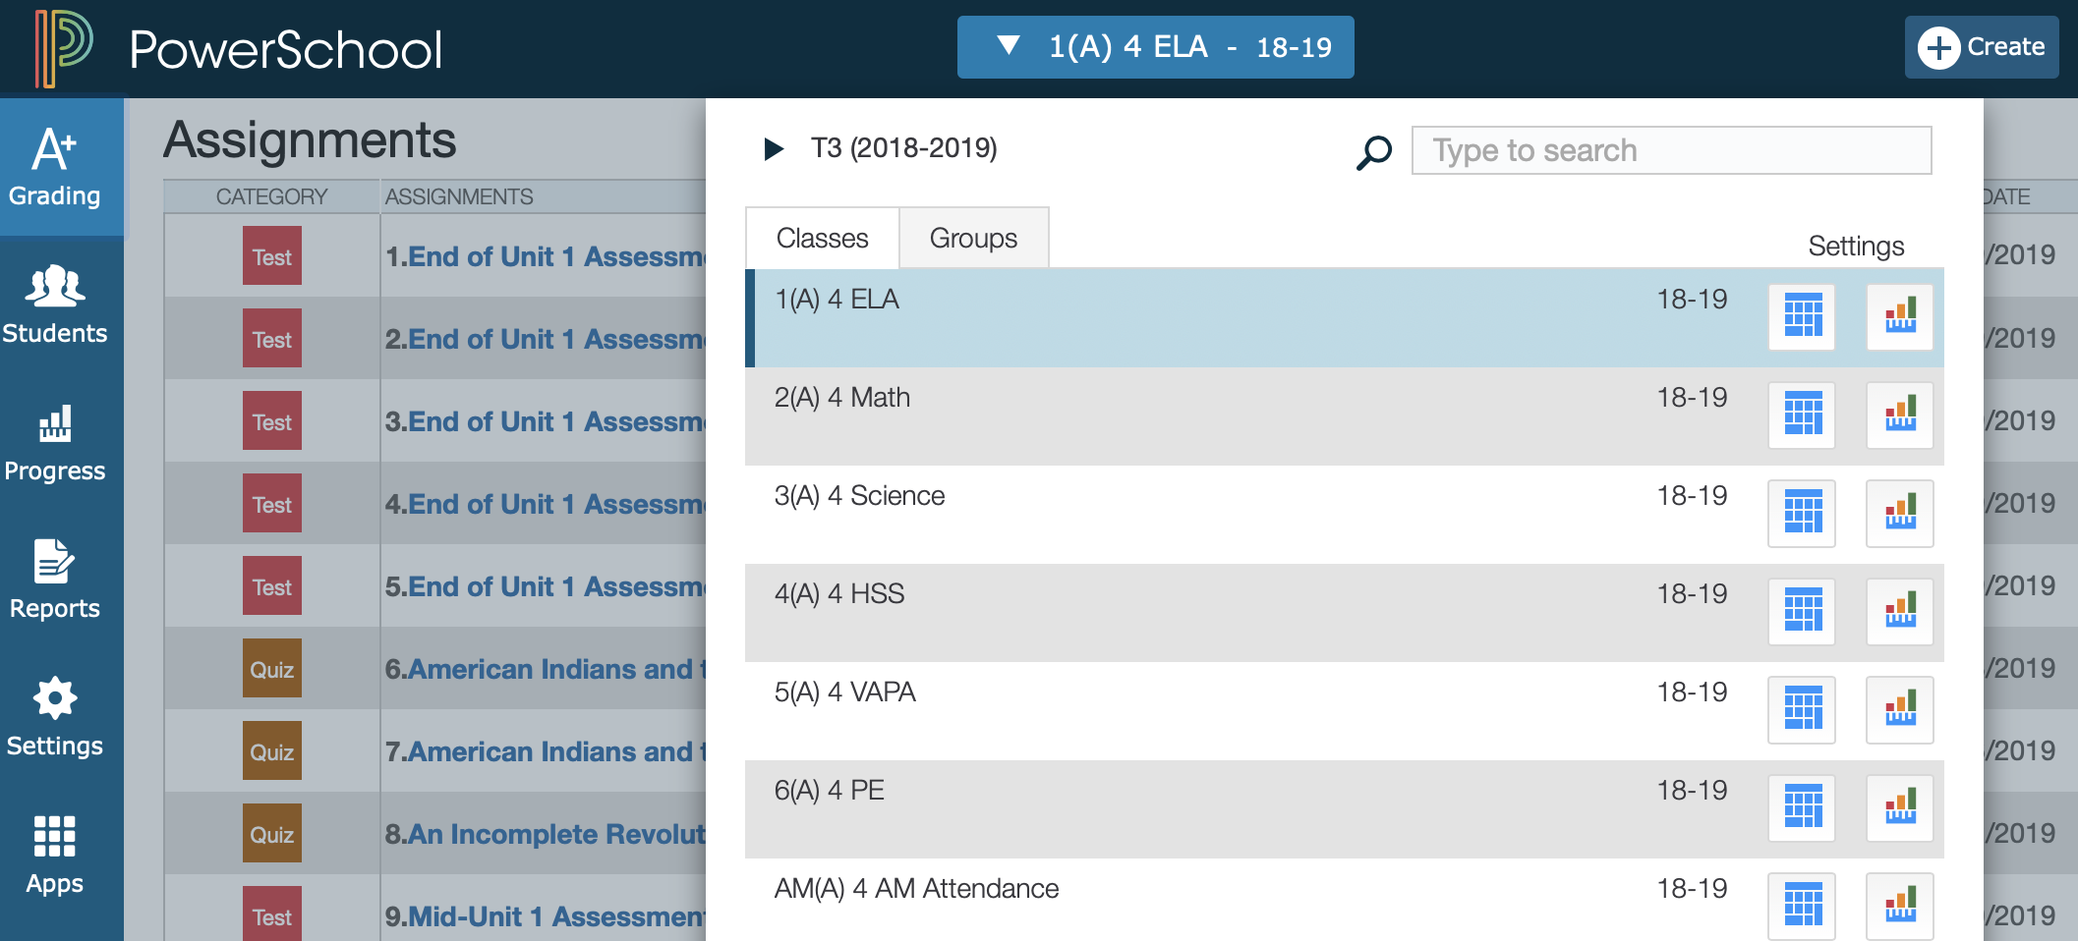
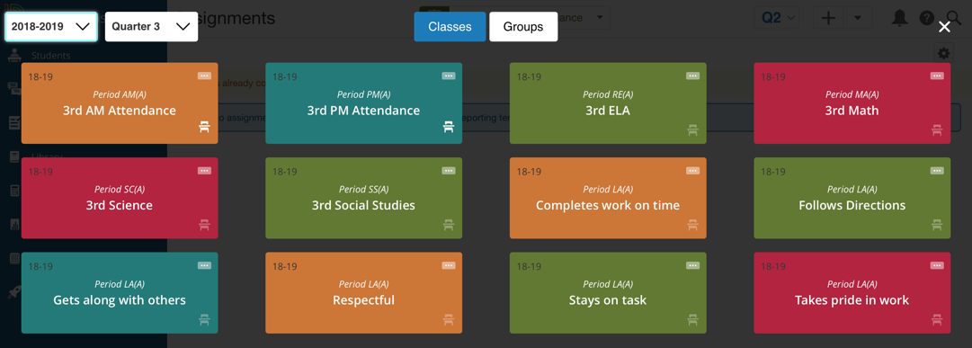
Accessing your sections/courses in PTP
Looks a bit different in Unified Classroom

Slide 9
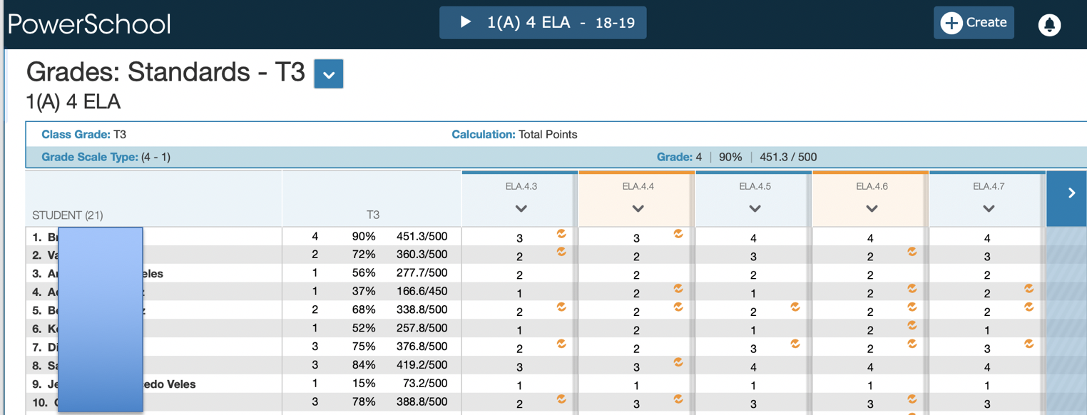
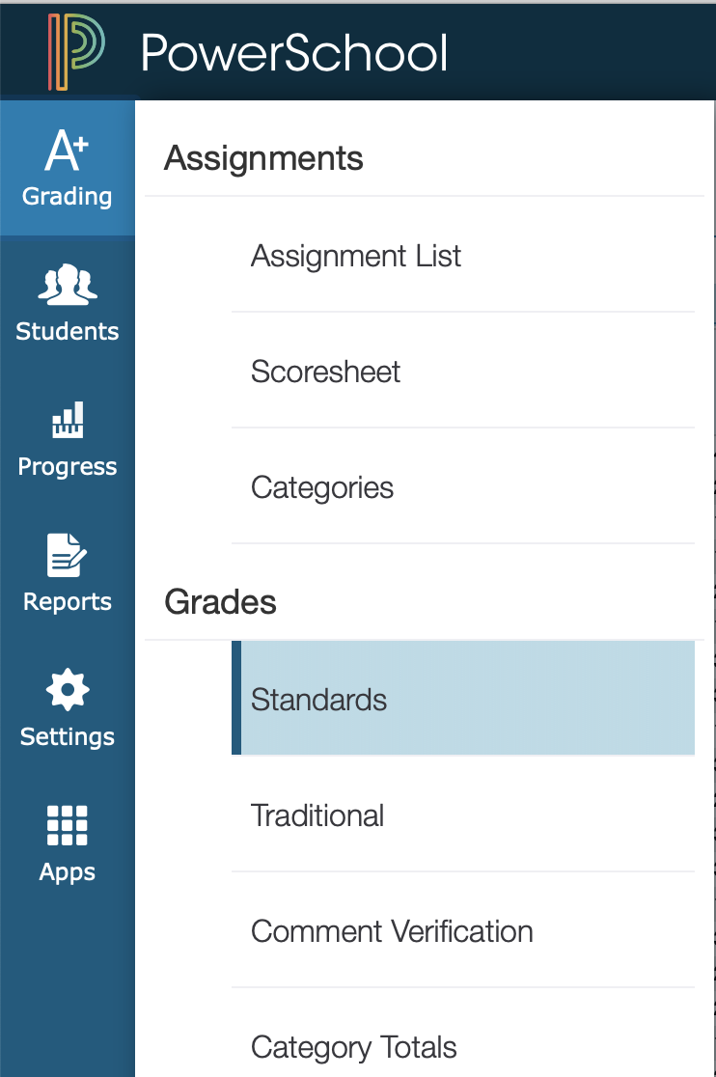
How to find and view your Standards in PTP
1(A) 4 ELA – 18-19. Provides you ELA Standards
> = How teachers access MORE ELA Standards

Slide 10
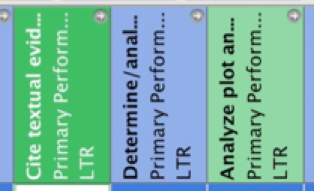

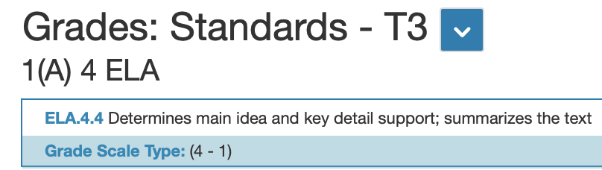
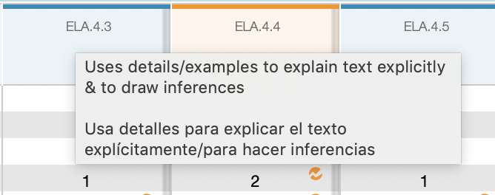
Displaying full Standard
Do you remember turning your head to view the standards in PTG??
PS 12.X - Hover over the Identifier and Standard Name and Standard Description will appear. This school used the description field to enter Spanish translation
The Name and Grade Scale will show up once you enter the grading cell!

Slide 11
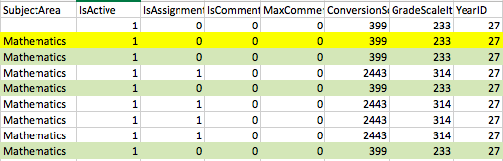
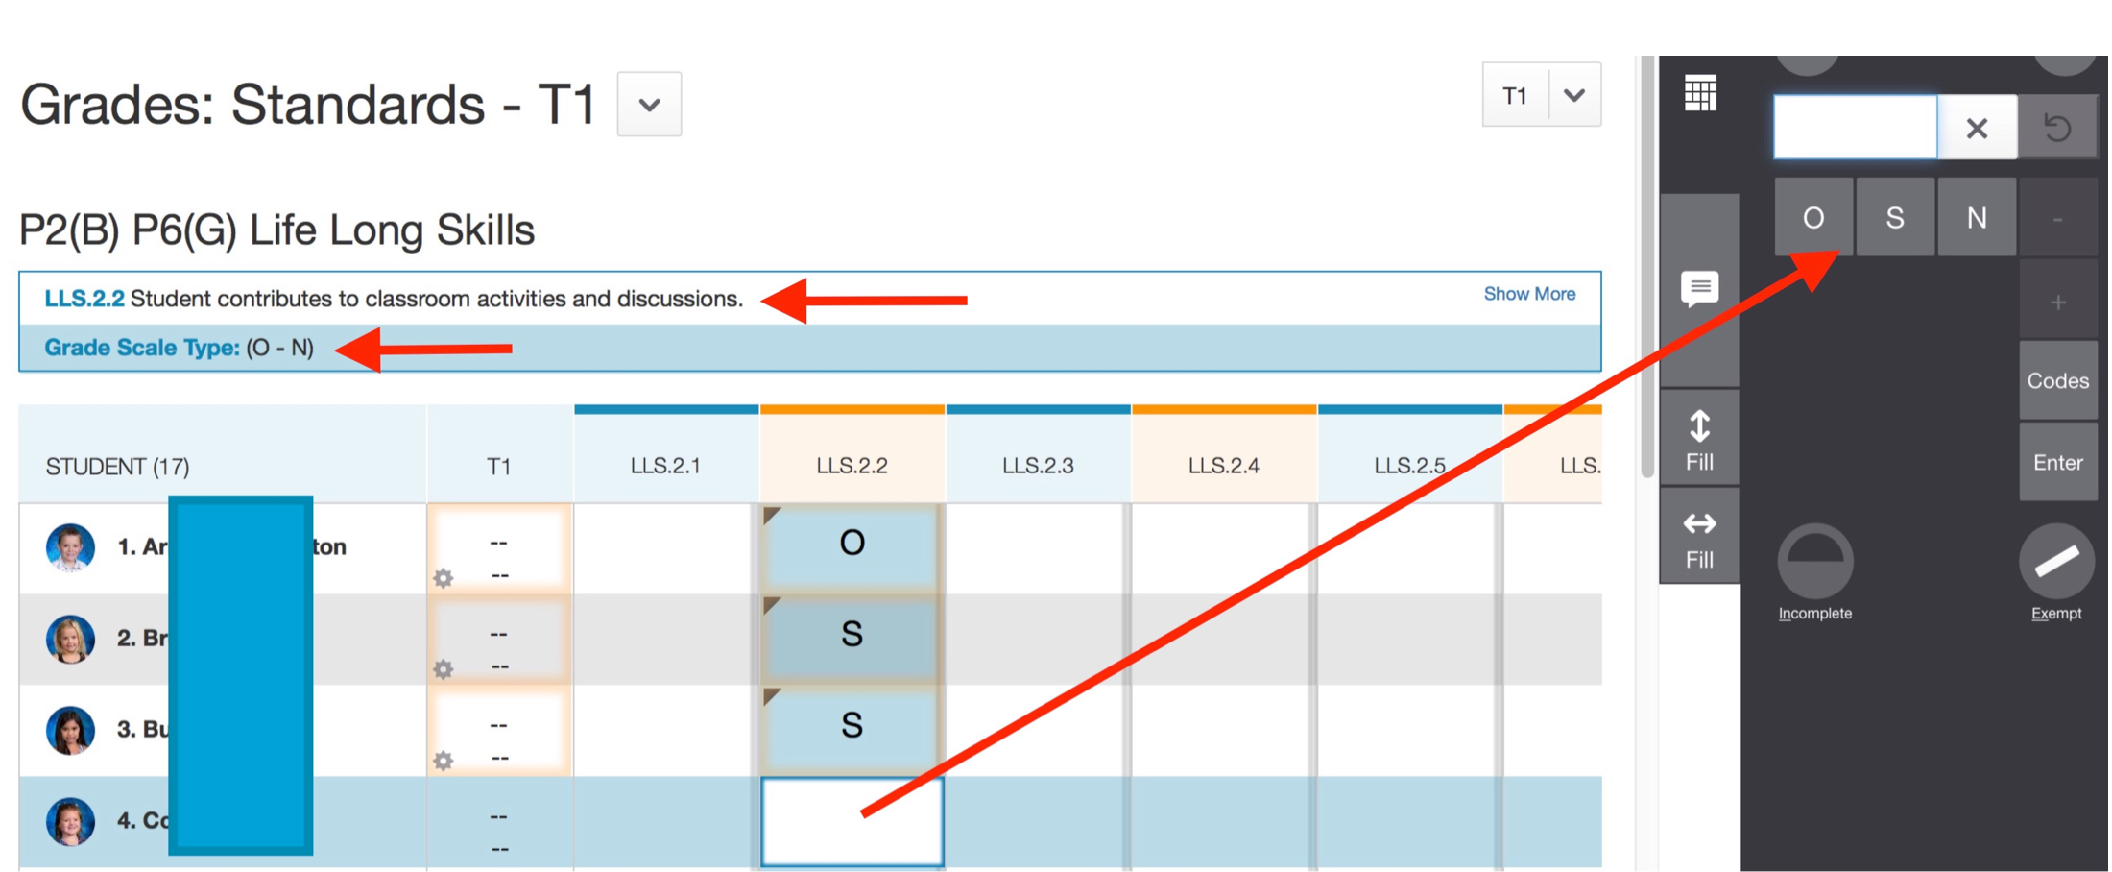
Grading Standards
Score Inspector.. Enter or Click

Slide 12
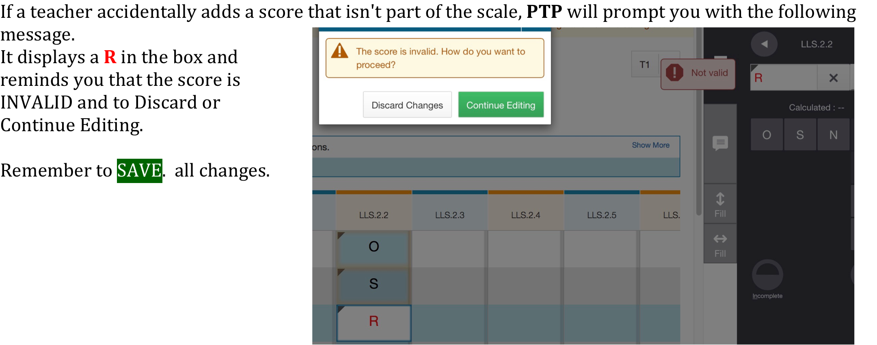
Notified if Error

Slide 13
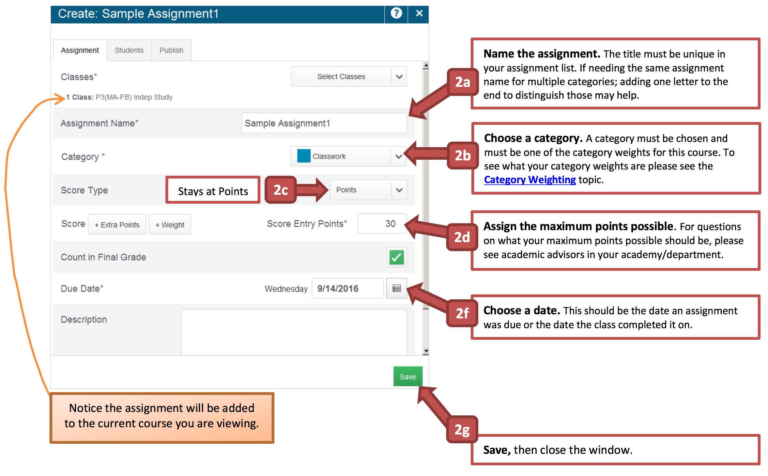
Creating an Assignment in PTP

Slide 14
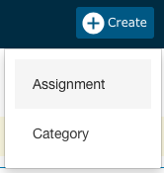
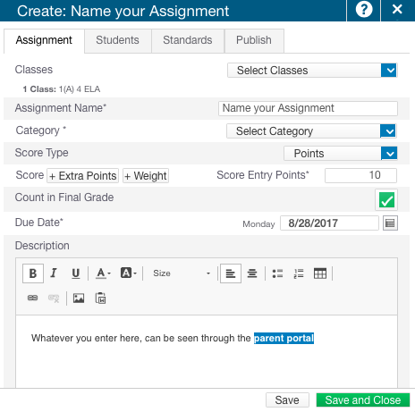
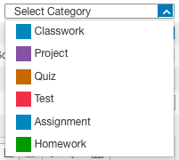
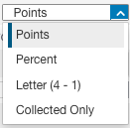
LET’S CREATE AN ASSIGNMENT…
BEST PRACTICES
CREATE ONE
ASSIGNMENT
WITH EACH
SCORE TYPE!

Slide 15
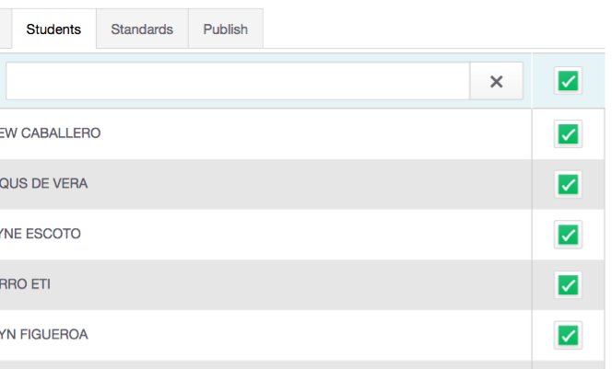
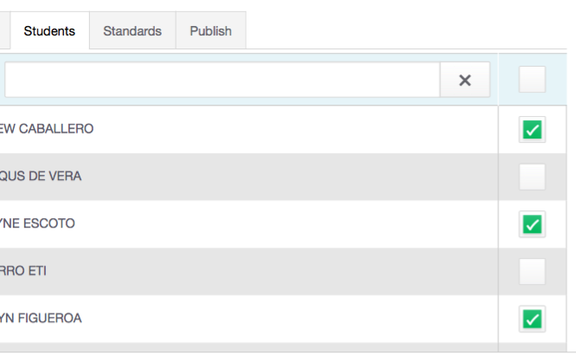
Assignments for specific students
By default all assignments are created for all students in that class and most of the time- you could skip this tab.
All students will have a √ in the box.
However, if you differentiate your instruction, you could create assignments for groups of students or just one. Simply remove the check boxes.

Slide 16
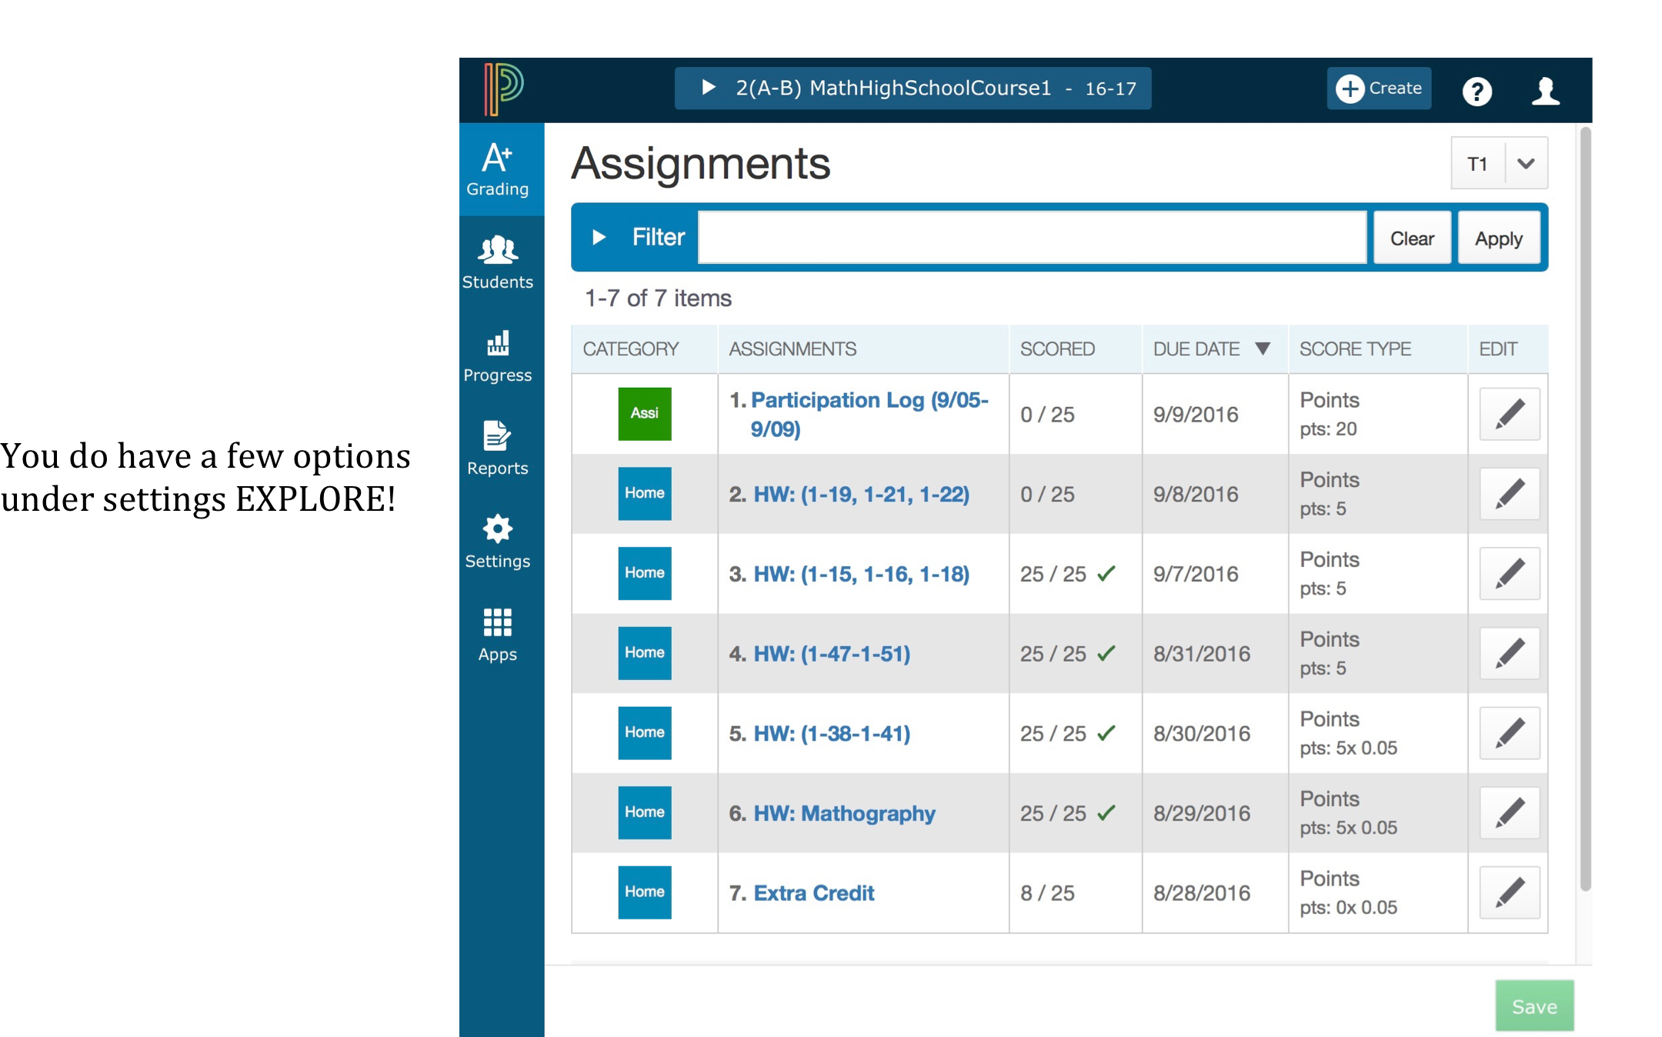
Options and the Edit Pencil

Slide 17
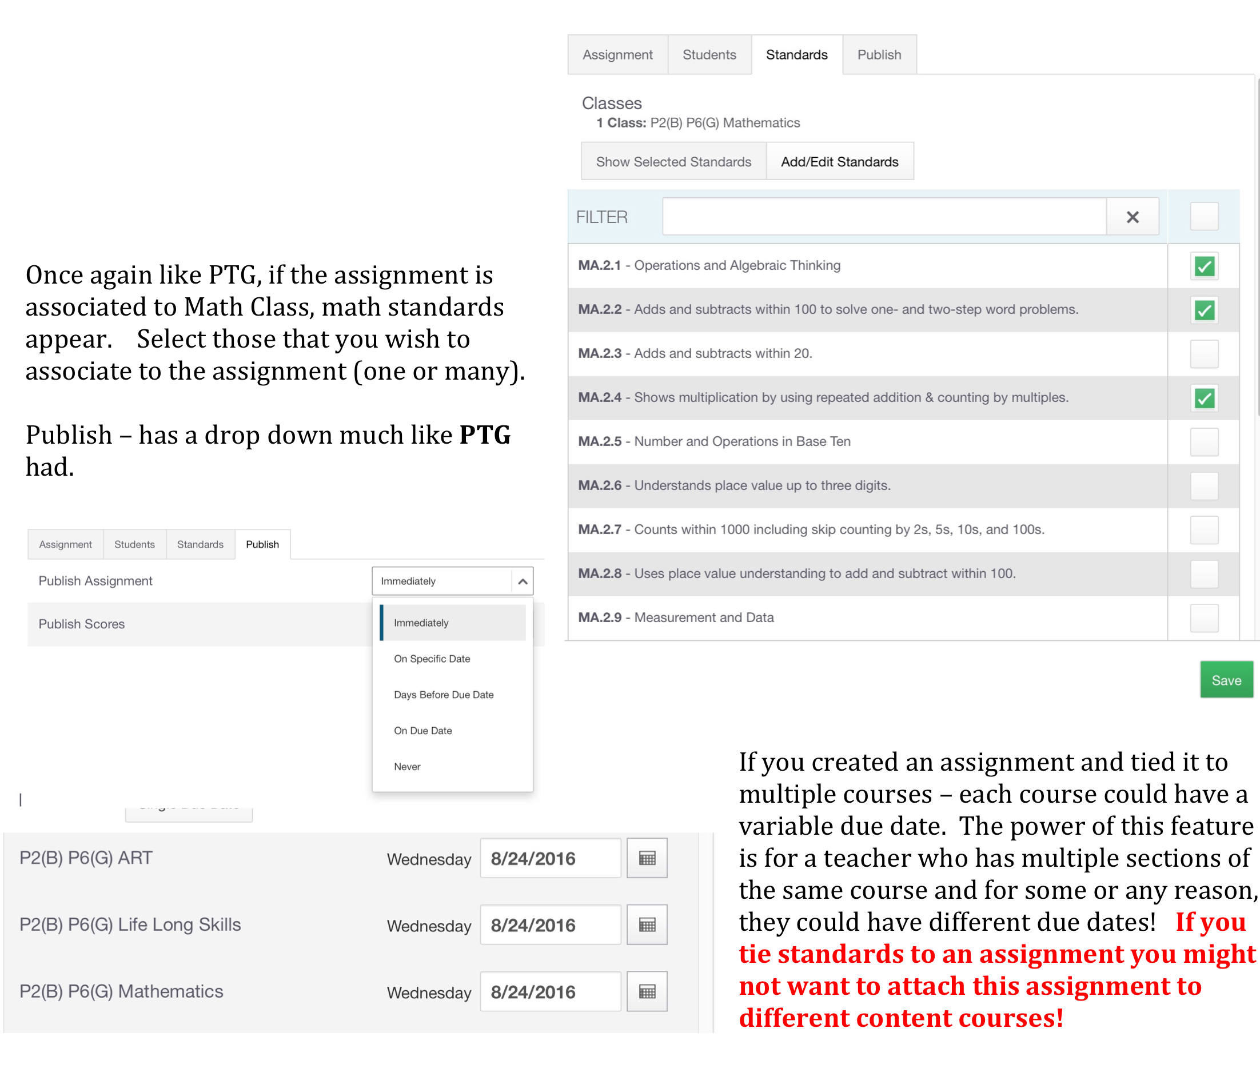
Selecting and Publishing

Slide 18
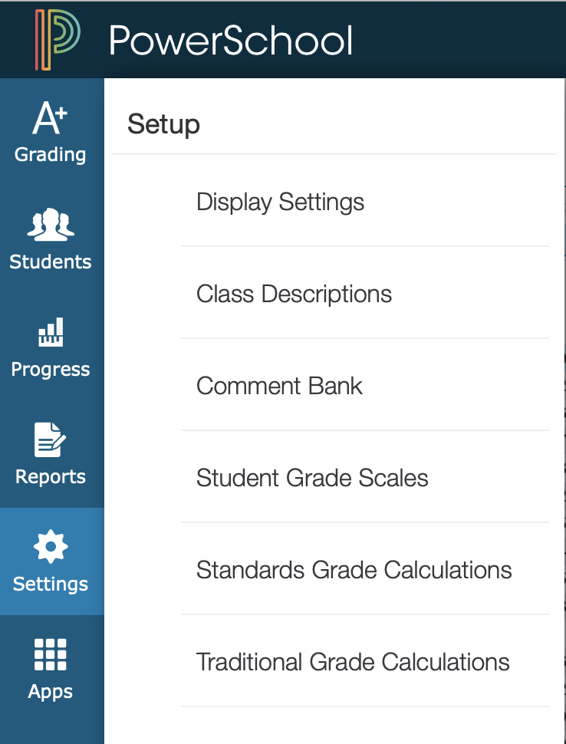
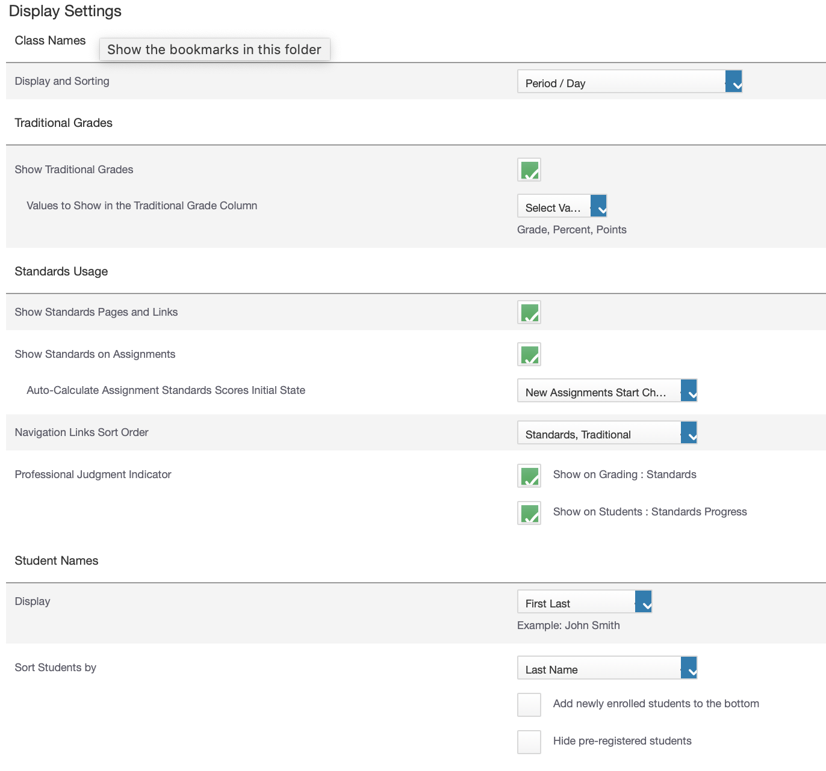

Settings
Auto Calculation
Option
must be set by the teacher!

Slide 19
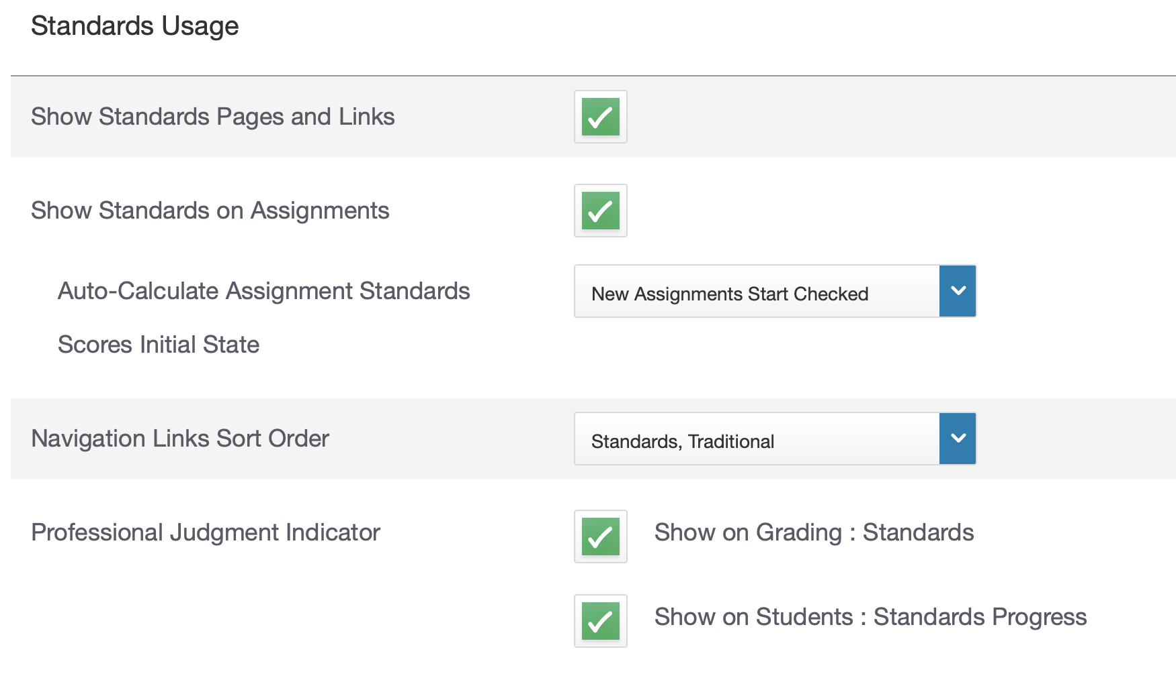
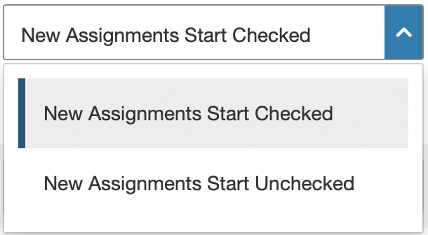
Assignment with Auto Calculated Scores
to selected Standards

Slide 20
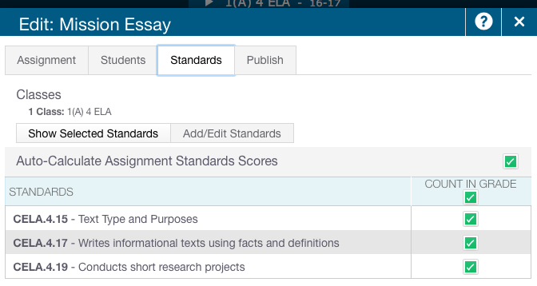
Assignment with Auto Calculated Scores
to selected Standards

Slide 21
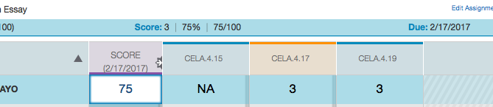
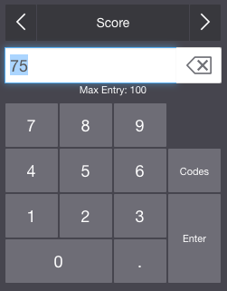
Scoring the Assignment (75) converts to the value of the standards
Score Inspector allows you to enter a score
Each standard receives the same value regardless

Slide 22
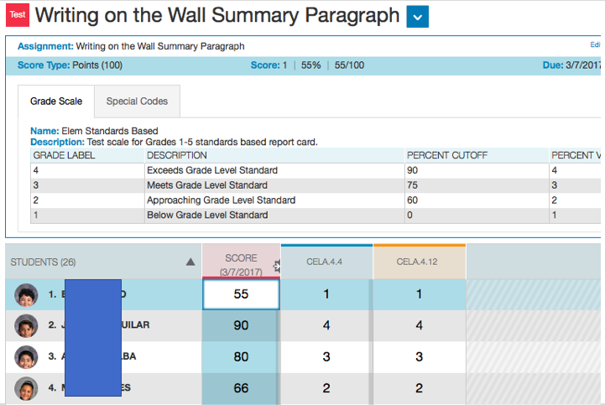

Slide 23
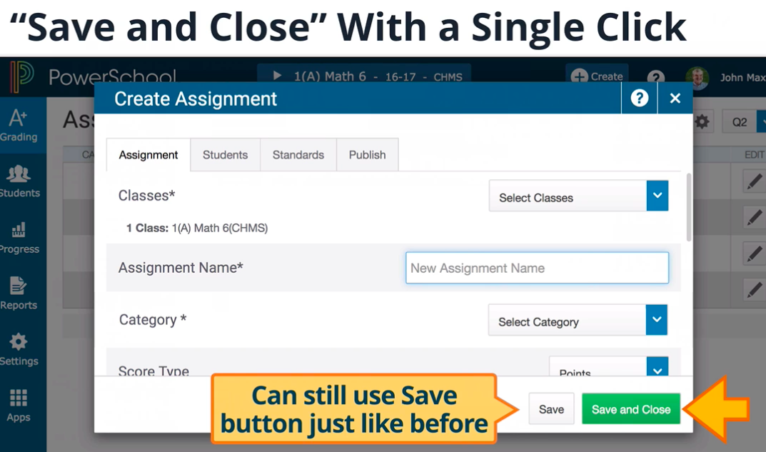
CLICK and SAVE
10.1.1

Slide 24
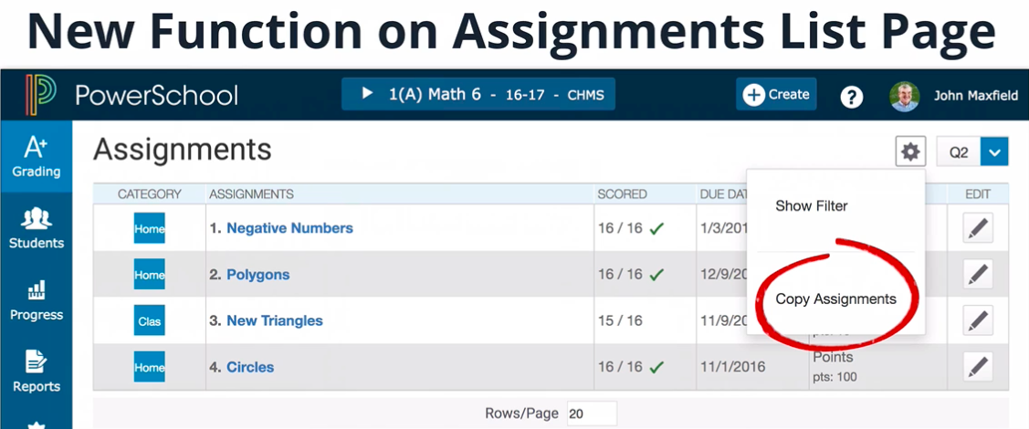
Copy Assignments
Remember – Assignments that have Standards associated to them
CAN’T BE COPIED TO OTHER SECTIONS which have different standards
10.1.1

Slide 25
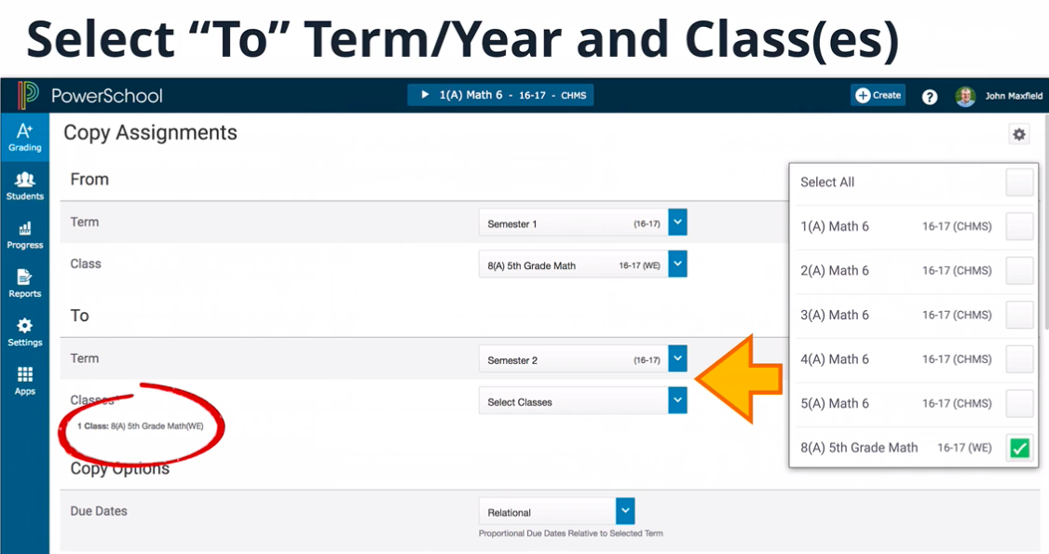
Copying Assignments – Term & Years
10.1.1

Slide 26
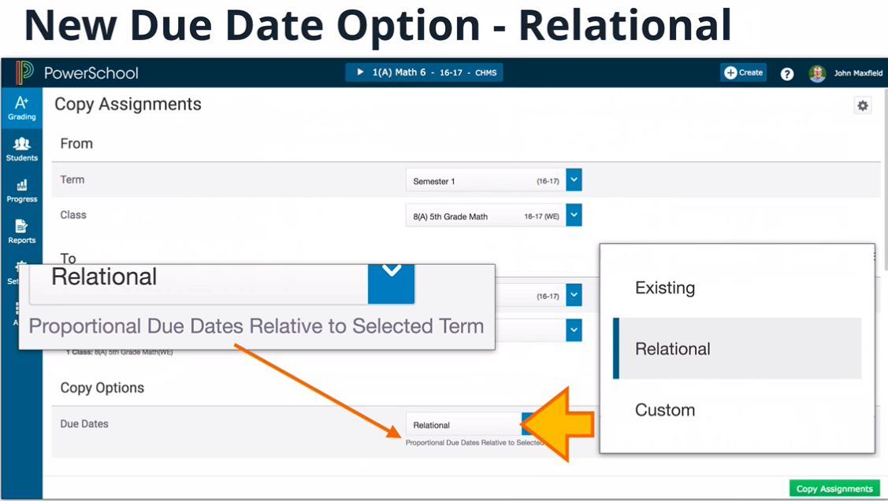
Copying Assignments – Relative Dates
10.1.1

Slide 27
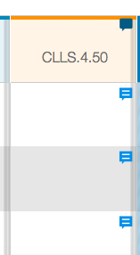

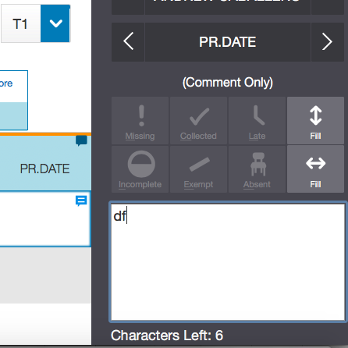
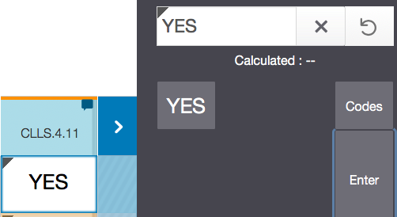
Accessing Standard Comment
Standards that allow comments will have a new lined bubble icon.
It will be filled in dark blue.
Click on the cells below and enter your narrative. Character Limit will display, CAN’T GO OVER!

Slide 28
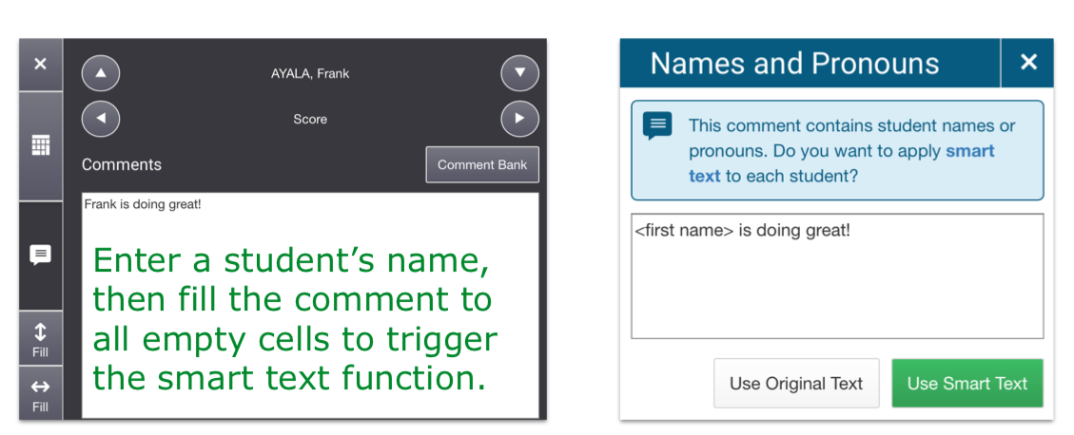
Smart Text Fill Down
Enter a comment with a student’s name-you can also use he/she, his/her
Save
Select that comment and FILL DOWN to get the Names and Pronouns
Message

Slide 29
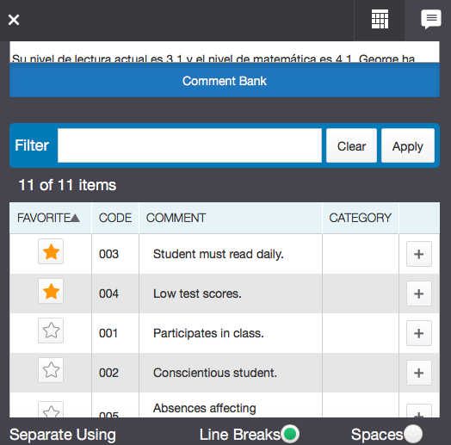
Comment Bank Location in PTP

Slide 30

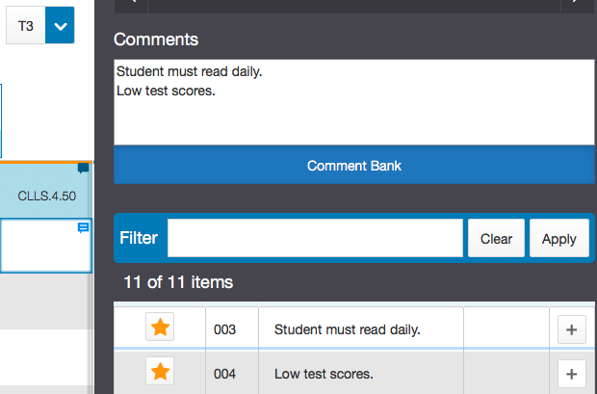
Comment Bank
Favorites and Selection

Slide 31
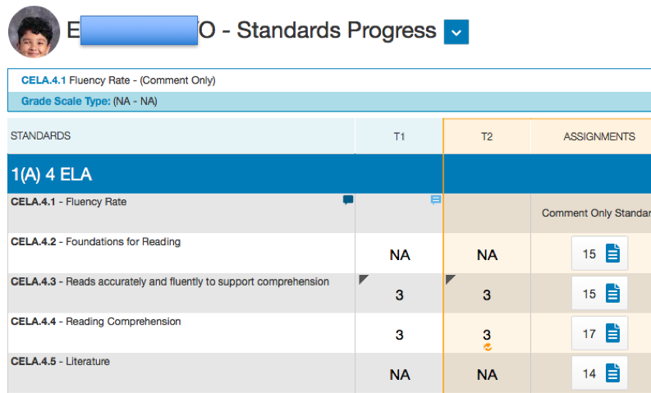

Slide 32
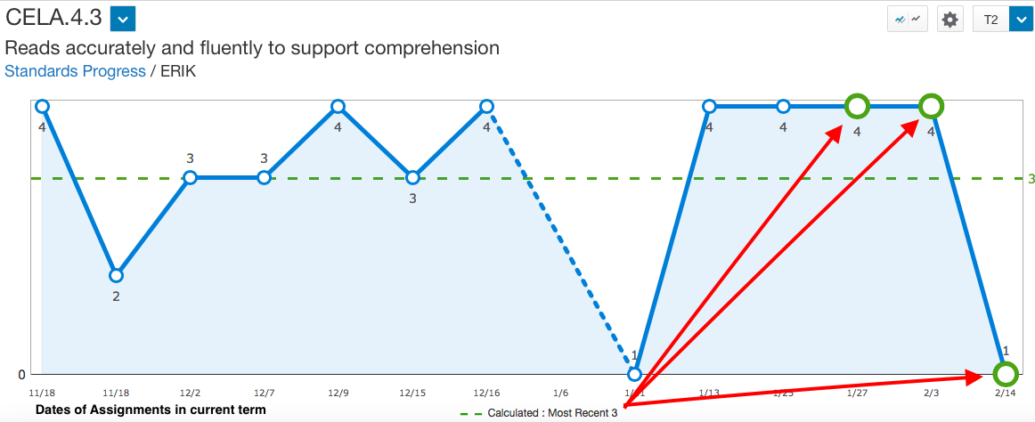
Student Progress – Teachers can change the Most Recent 3

Slide 33
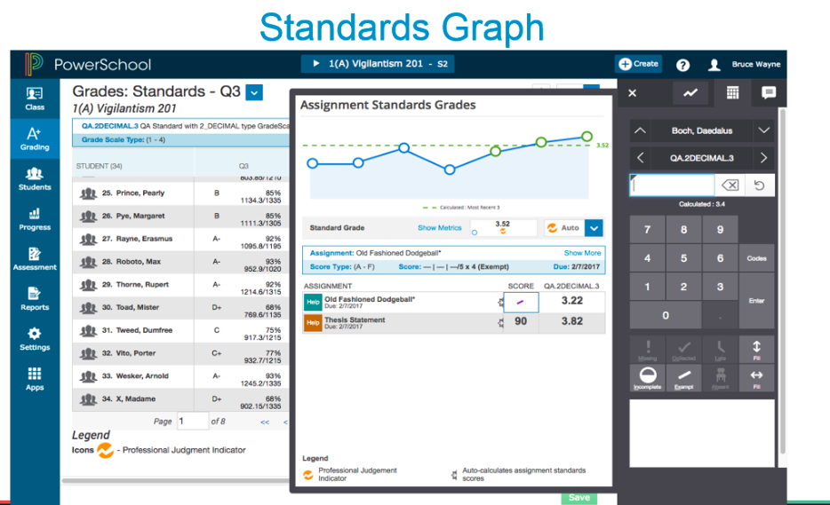
EVEN SIMPLIER w PS V 11.0.4.1 (Jan)

Slide 34


Professional Judgment Indicator
If you work with standards grades, the Professional Judgment Indicator is designed to assist you in assessing standards grades.
The indicator helps you understand which grades to focus on to determine if the final grade accurately reflects the student’s level of understanding.
Here’s an example of when the indicator appears:
The most recent scores for a standard are 1, 1, 1, 4, and 4, respectively, and all have different metrics. The Professional Judgment Indicator appears on the calculated final grade field to bring to your attention to the fact that one of the three most recent scores is actually higher than the final grade.
Using your professional judgment, you can decide how you want to impact the final grade. You may override the final grade, or you can make the score anomaly exempt.

Slide 35
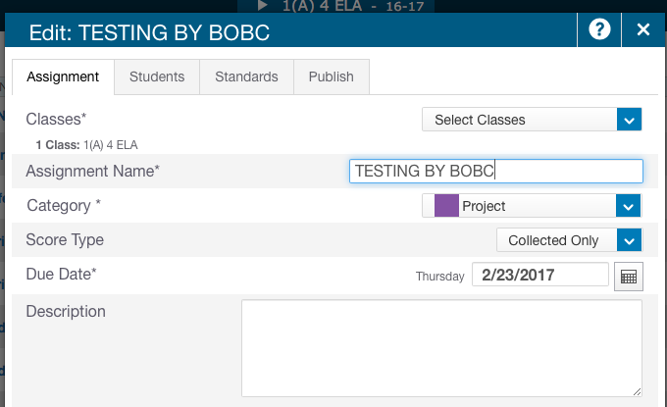
Collected Only – Score Type
Auto Calculation Concerns

Slide 36
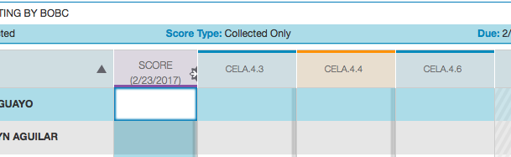
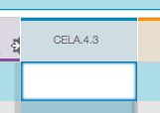
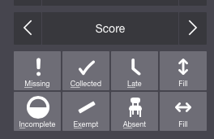
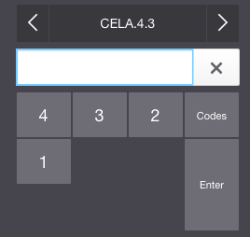
Collect Only Assignments
Doesn’t allow a score to be entered!
Each standard can now receives different values per standard.

Slide 37
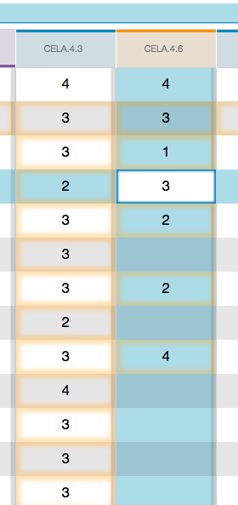
FILL ALL & CHANGE OR GRADE SOME & FILL
Some teachers may prefer to grade all students with a fill down 3 and changes those they evidence for that have done better or worse!
While other teacher may prefer to grade specific students with 4/2/1 and fill the rest with a 3. Teach them how to do it both ways!

Slide 38





FILL IN OPTIONS – DOWN or ACROSS
TIP – CAN’T FILL DOWN TWICE.. AH YOU CAN!

Slide 39

Migrating Teachers from PTG to PTP

Slide 40

Admin and Teacher Involvement

Slide 41


Slide 42




PTP MIGRATION DASHBOARD by Adam Larsen
www.auroraedtech.com
https://support.powerschool.com/exchange/view.action?download.id=845
If you run this from the district you will get display all your divisions or campus

Slide 43

An ALL term!
10.1.1

Slide 44

Metrics
10.1.1

Slide 45


NUMERIC SCALES – RANGE & INCLUDE

Slide 46

AUTO GENERATE THE TABLE

Slide 47
PowerSchool Insider by Jason Springel
16
BINGE
WATCH
https://support.powerschool.com/d/insider

Slide 48


More in-depth Grade Scale Info
Episode 12 3/24/17
11 MIN TIME STAMP

Slide 49




NEW in PS 12
Teacher Comment Banks – returns to PTP from PTG

Slide 50




NEW in PS 12
Copying and Pasting Grades

Slide 51



NEW in PS 12
Locking Gradebooks

Slide 52
Q & A
ANY AND ALL DERO RESOURCES ARE AVAILABLE
TO DOWNLOAD, TWEAK and USE FOR YOUR DISTRICT!
Bob Cornacchioli
DERO Technical Services
bcornacchioli@gmail.com
get2bobc@gmail.com
www.derotechnical.com

